Slide 1
Superconductors
Esteban Langarica Vargas

Slide 2
Index
History
Definition
Characteristics
Properties
examples
Applications
Conclusions

Slide 3
What is a superconductor?
Superconductor materials don’t show off any resistance on any determined conditions as the electric currents go on, what they do is that these help such conditions to get heaten up through the Joule effect, this is why there is no energy loss. This phenomenon is produced when its Critic Temperature gets cooled down.

Slide 4
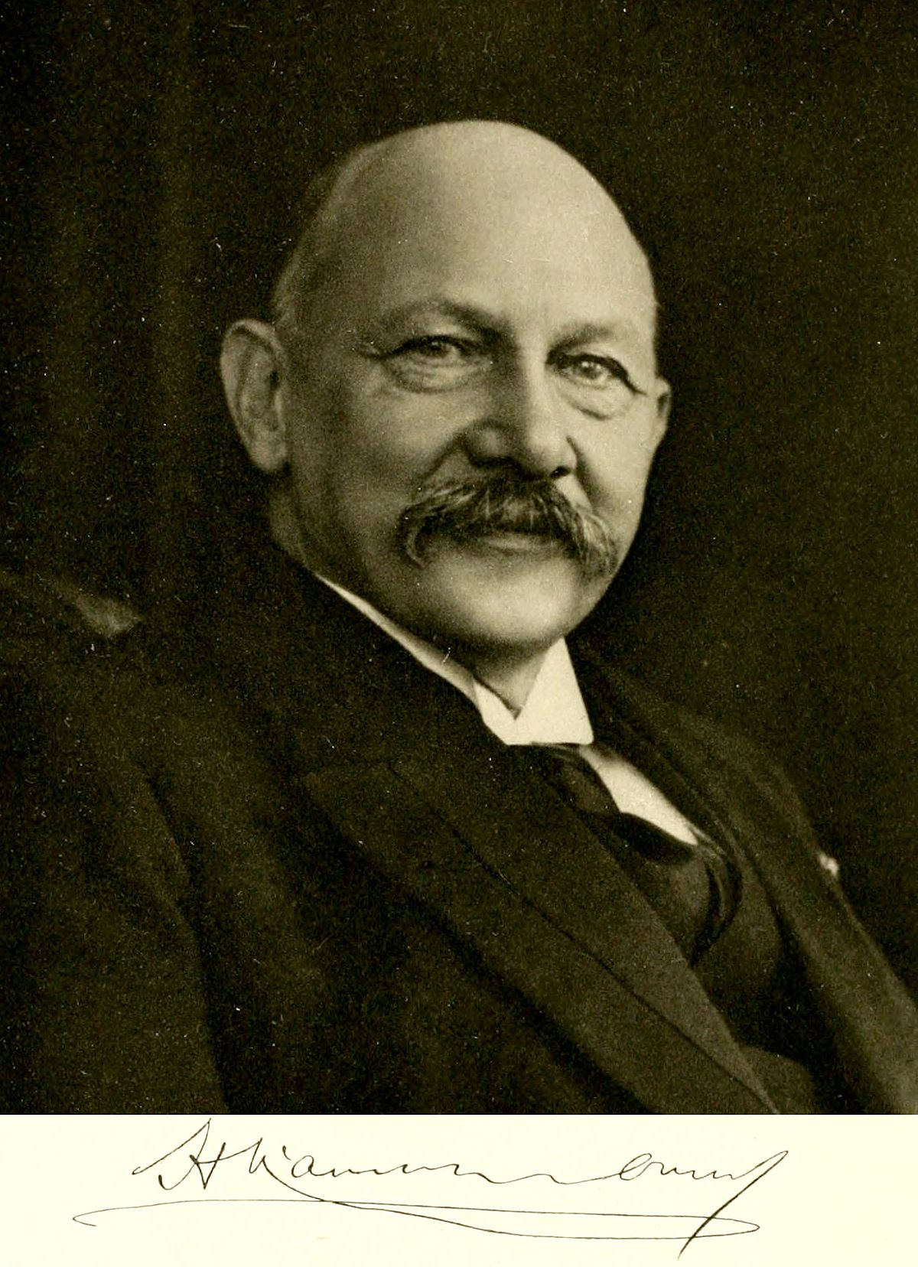
History

Slide 5
Characteristics

Slide 6
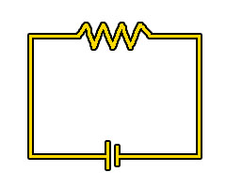
The main characteristic of conductor-materials is that, during the absence of magnetic fields, below it’s critic temperature, their resistivity becomes identically null (inside the limits of its measures, of course) This transaction gets produced abruptly as it is a change on the phase. Above the critic temperature, resistivity is finite, in which the critic temperature produces a discontinuity leap, and is null delow it.

Slide 7
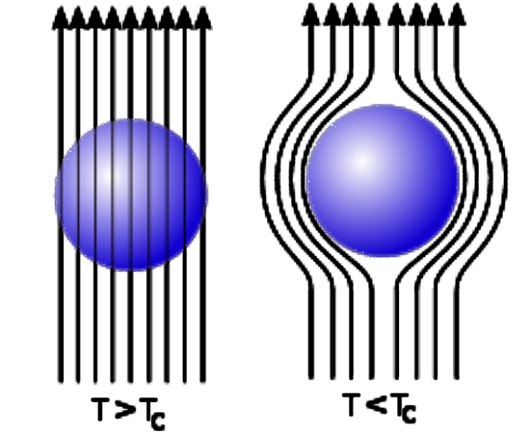
The superconducting state is not only characterized by zero resistance, but also by the response of magnetic fields applied to it. The applied magnetic field can have sufficient intensity to reach the critical phase and penetrate the material, or the superconductor can be protected from the applied magnetic field and internal superconducting currents appear that shield the external field and prevent it from penetrating the material.

Slide 8
Applications

Slide 9
magnetic levitation train

Slide 10
The suspension is that the superconductor will reject the magnetic field lines so that they do not pass inside, which will cause the levitation of the train. As the train moves along the rail a current will be induced in the coils of the latter which will then act as electromagnets. When interacting with superconductors mounted on the train, levitation occurs

Slide 11
particle accelerator

Slide 12
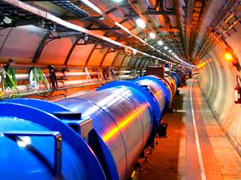
Dispositives that use electromagnetic fields to accelerate particles (electrons, ions or protons) charged at very high speeds make them collide with others, thus generating new ones generally unstable and of very short duration

Slide 13
conclusions

Slide 14
References
http://www.unizar.es/icma/divulgacion/pdf/pdflevitsupercon.pdf_técnica http://www.biblioteca.org.ar/libros/90080.pdf http://www.monografias.com/trabajos82/materiales-superconductores/materiales-superconductores2. shtml#tipodemata http://fundamental.fis.ucm.es/trabajosFinMaster/trabajos0809/jonathan-correa.pdf http://www.investigacionyciencia.es/Archivos/06-07_Vicent.pdf http://usuarios.fceia.unr.edu.ar/~fisica3/MagLev.pdf http://www.transrapid.de/ http://biologiaemocional.blogspot.com/2011/09/la-magnetoencefalografia-como-tecnica_02. html http://genaltruista.com/notas2/g111077.pdf http://www.textoscientificos.com/fisica/superconductividad/almacenamiento-energiahttp://www. hola.com/salud/enciclopedia-salud/2010050145472/deporte-ejercicio/lesiones-deportivas/ resonancia-magnetica-nuclear-rmn/1/ http://www.tecnun.es/asignaturas/PFM_Mat/Prog/Supercv2.pdf http://www.nexans.es/

